Slide 1
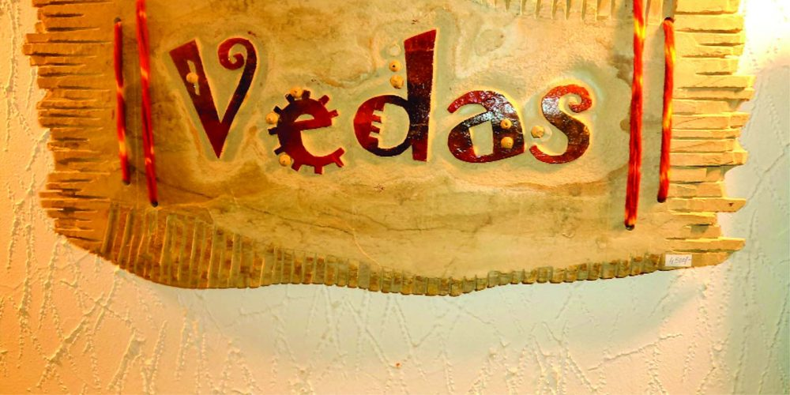
VEDAS:
TOPIC BY Dr. Priyanka Somasundaram

Slide 2
Introduction:
Sanskrit word – “vid” (to know) – Veda (knowledge)
Vedas form core of the Sanatana Darma (its explained in – Rigveda)
“Mantra – Drastas” (those who saw he mantra, not those who created the mantras)
Eg:
Columbus discovered America
Newton
Einstein
The same way – Mantras

Slide 3
Important of Sruti:
Vedas – Sruti - Hearing (Srotra - Ear)
the vedas - handed down orally from generation to generation and have not been taught or learned from written text.
Each Vedic hymn - Equal of several Self Improvement books.
The mantra - most efficacious only if each syllable is chanted with precision ( sounds & textual correctness are concerned)

Slide 4
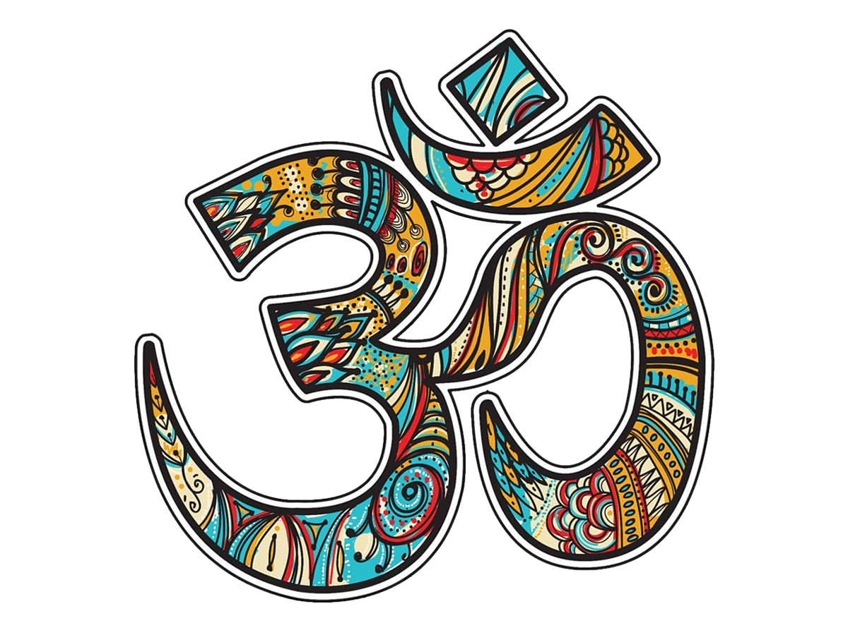
HYMN
A lyric poem or song addressed to a divine being.
Praising the power & wisdom

